Slide 1
Introduction to Tidyverse
R Workshop Series: Part 2
Cornell Center for Social Sciences
2/16/2022

Slide 2
The Cornell Center for Social Sciences provides a welcoming environment for everyone embracing all backgrounds or identities. All instructors and attendees agree to abide by our community norms. We encourage the following behaviors in our workshops:
Respect differing viewpoints and ideas
Share your own perspectives and ask any questions
Accept constructive criticism
Use welcoming and inclusive language
Show courtesy and respect for all instructors and attendees
If you believe that an instructor or attendee has violated the code of conduct, please report the violation to ccss-researchsupport@cornell.edu. We take all reported incidents seriously.

Slide 3
Land Acknowledgement
Cornell University is located on the traditional homelands of the Gayogo̱hó꞉nǫ' (the Cayuga NatiCCSS-RS@cornell.eduon). The Gayogo̱hó꞉nǫ' are members of the Haudenosaunee Confederacy, an alliance of six sovereign Nations with a historic and contemporary presence on this land. The Confederacy precedes the establishment of Cornell University, New York state, and the United States of America. We acknowledge the painful history of Gayogo̱hó꞉nǫ' dispossession, and honor the ongoing connection of Gayogo̱hó꞉nǫ' people, past and present, to these lands and waters.
Educate yourself on land-grab universities and the movement to return stolen lands to indigenous people.

Slide 4
What is Tidyverse?
Opinionated collection of R packages designed for data science
dplyr – Data Manipulation
tidyr – Create tidy data in a consistent form
stringr – String Manipulation
readr – Data Importing and Reading
ggplot2 – Visualization
purr – Functional Programming Toolkit
tibble – Data Organizer
forcats - Factor Manipulation

Slide 5
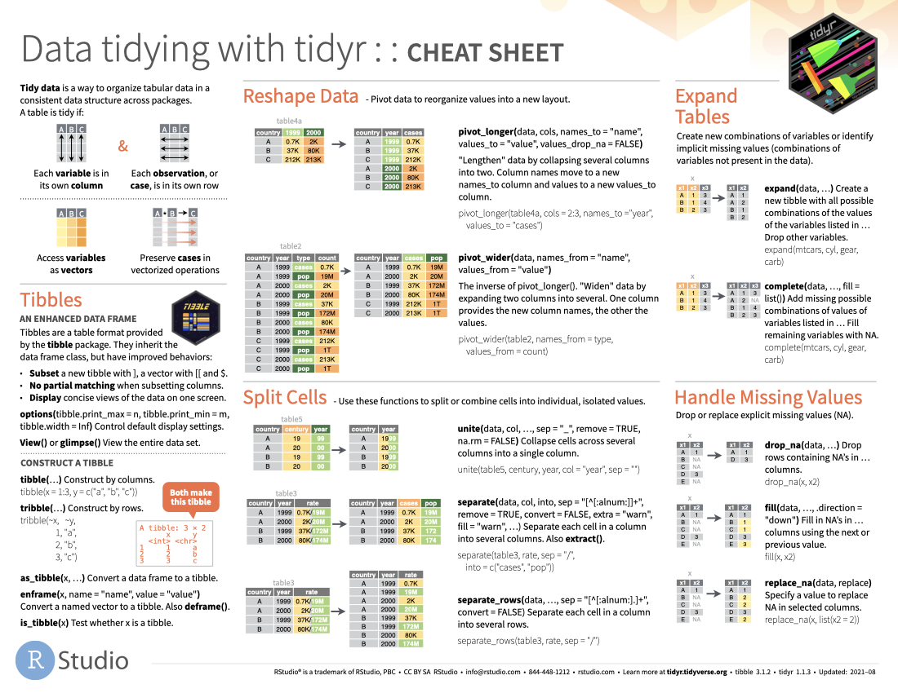
Rstudio Cheatsheets
https://www.rstudio.com/resources/cheatsheets/

Slide 6
Let’s Do Some Exercises
Open your RStudio environment
Use a local instance of RStudio
Launch a cloud version of RStudio using our Binder image
https://mybinder.org/v2/gh/ccss-rs/R-Workshop-Series/main?urlpath=rstudio
If using this option, please download any code you have written prior to closing the tab. Changes will not be saved.

